Slide 1

Comprehensive Analysis of Pokemon data
Under the guidance of
Dr. Mark Chai
Team: Data Wizards Manasa Akula - S560998 Mounika Jakkula S560445 Gayathri Nangineni - S559973 PoojaSri Ramineni - S559300

Slide 2
Project Outline
PySpark analysis of the Pokemon dataset explored characteristics, evolutionary paths, and trends across generations.
Insights provide valuable knowledge for mastering battles, understanding rankings, and gameplay mechanics.
By leveraging PySpark, we delved into Pokemon lore, unraveling mysteries and empowering trainers to become masters.

Slide 3
Dataset
Domain: https://www.kaggle.com/datasets
Data File: https://www.kaggle.com/datasets/bhavyadhingra00020/complete-pokemon-dataset-9th-gen-img-tabular
Number of records and columns: 1025 records, 18 columns

Slide 4
Methodologies and Tools
Data Integration: Kafka
Data Analysis: Python(Pandas, NumPy), Pyspark
Visualization: matplotlib library for generating insightful charts and visualizations. Tools: JupyterNotebook

Slide 5
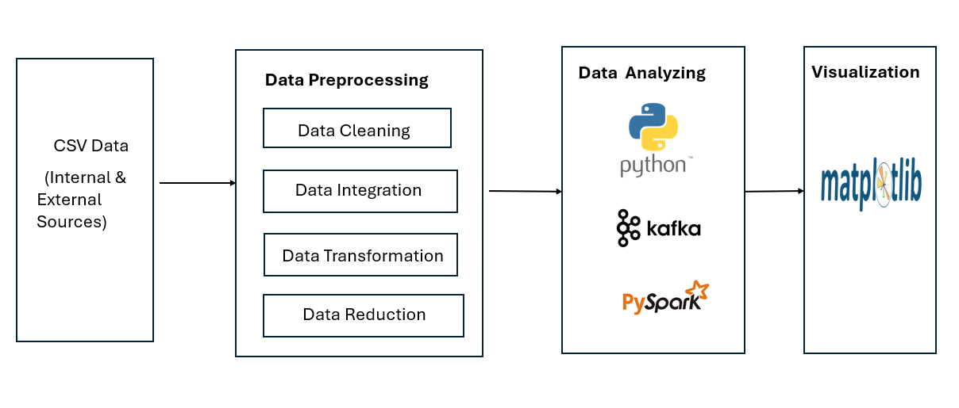
Architecture Diagram

Slide 6
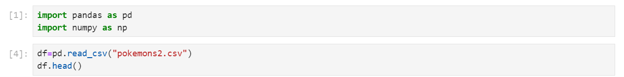
Processing of data for the analysis
Step-1: Importing Modules and Loading Data

Slide 7
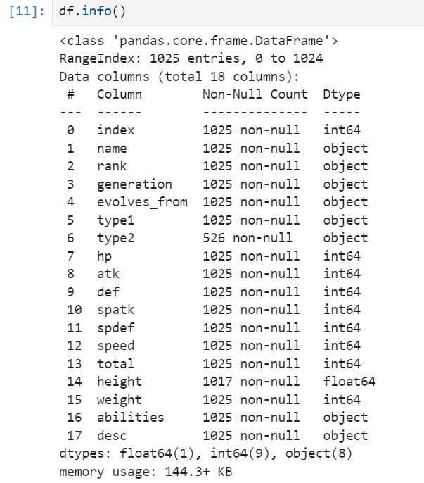
Step-2: Datatypes of the Variables

Slide 8
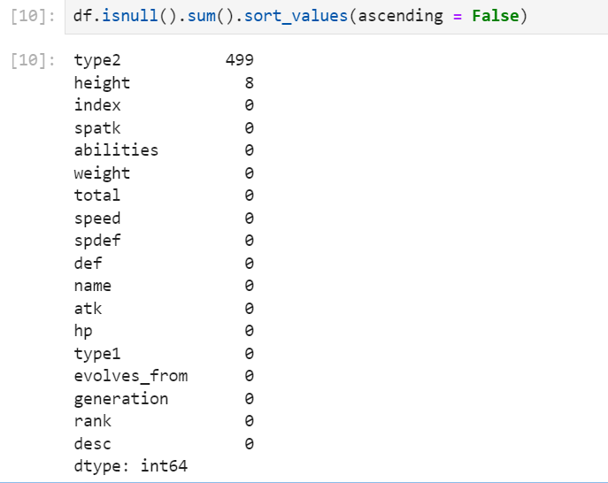
Step-3: Missing Data

Slide 9
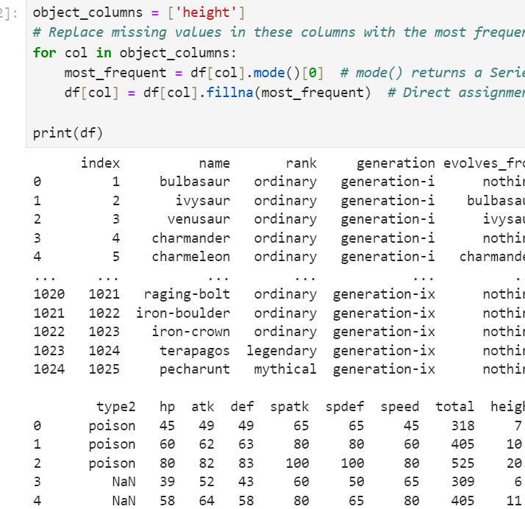
Step-4: Replacing with mean values

Slide 10
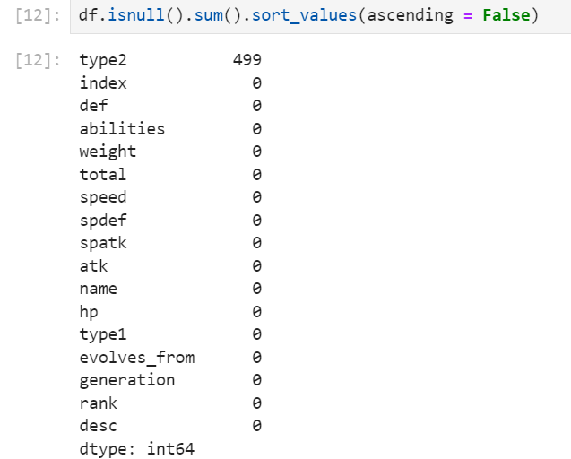
Step-5: Replacing with mean values

Slide 11
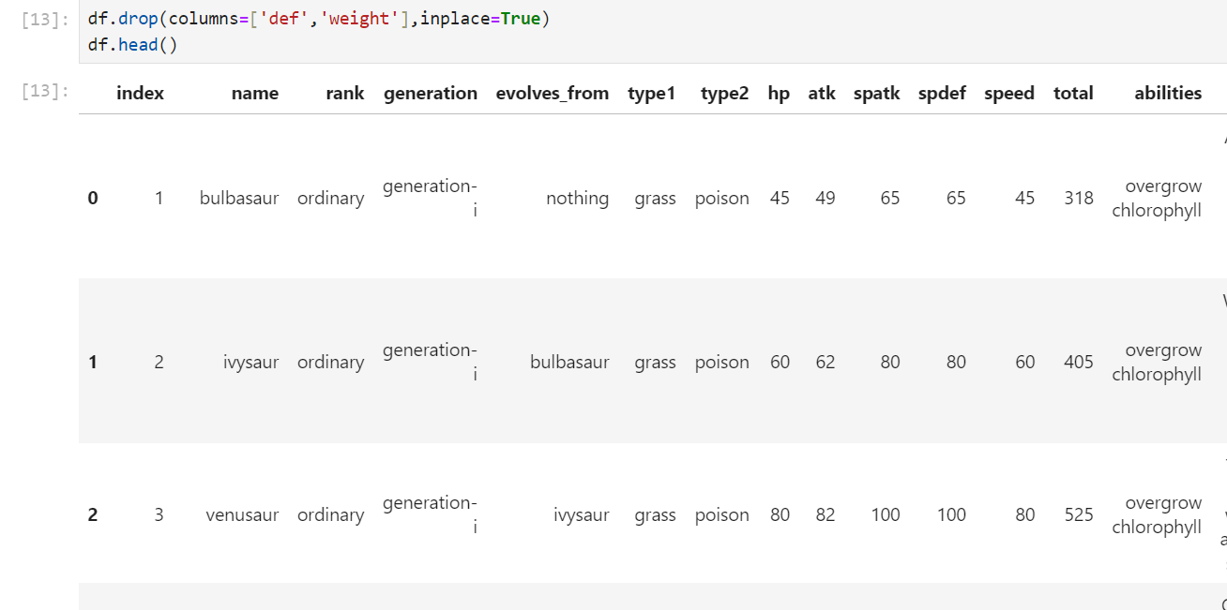
Step-6: Dropping of Columns

Slide 12
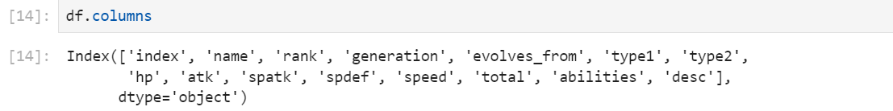
Step -7: Columns after dropping some of them

Slide 13
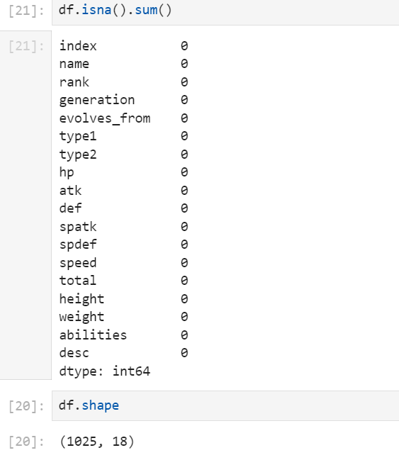
Step-8 : Checking null values and column information after dropping some columns.

Slide 14
Step-9: Saving cleaned dataset

Slide 15
Project Goals
Goal-1: Statistical Analysis of Base Stats: Conducting a statistical analysis of the base stats (hp, atk, def, spatk, spdef, speed, total) to identify the average, median, and variation of stats among different Pokemon generations or types, providing insights into the overall power balance in the Pokemon world.
Goal-2: Physical Attributes Exploration: Examining the physical attributes of Pokemon, such as height and weight, to understand the diversity and distribution of sizes among different species, and investigate whether there are any correlations between physical attributes and other characteristics like base stats or evolutionary stage
Goal-3: Ranking Analysis: Analyzing Pokemon rankings to understand the factors influencing a Pokemon’s rank, such as its base stats, evolutionary stage, or abilities, and identify any patterns or trends in how Pokemon are ranked across different generations or types.

Slide 16
Goal-4: Generation Trend Analysis: Analyzing trends in Pokemon characteristics (such as base stats, types, and abilities) across different generations to understand how the Pokemon universe has evolved over time and identify any significant changes or developments in gameplay mechanics.
Goal-5: Weight-Class Segmentation: Segmenting Pokemon based on weight classes (e.g., lightweight, middleweight, heavyweight) to analyze how weight influences factors like base stats, abilities, and evolutionary patterns, and identify any correlations between weight class and competitive performance.
Goal-6: Descendants Analysis: Investigating the descendants of Pokemon species by tracing the evolutionary paths of Pokemon mentioned in the evolves from column, identifying any evolutionary trends or patterns that emerge across generations and types of Pokemon.
Goal-7: Legendary Pokémon Analysis: Exploring the characteristics and attributes of legendary Pokemon, including their base stats, abilities, and rarity, and analyze how they differ from non-legendary Pokemon in terms of gameplay mechanics and competitive viability.
Goal-8: Ranking Analysis: Analyzing Pokemon rankings to understand the factors influencing a Pokemon’s rank, such as its base stats, evolutionary stage, or abilities, and identify any patterns or trends in how Pokemon are ranked across different generations or types.

Slide 17
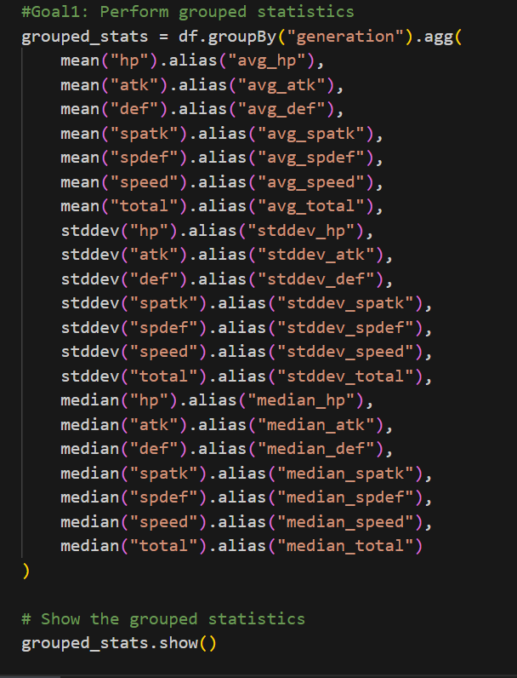
Goal 1: Statistical Analysis of Base Stats Conducting a statistical analysis of the base stats (hp, atk, def, spatk, spdef, speed, total) to identify the average, median, and variation of stats among different Pokemon generations or types, providing insights into the overall power balance in the Pokemon world.

Slide 18
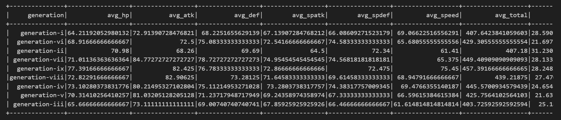
Goal1 - Output:

Slide 19
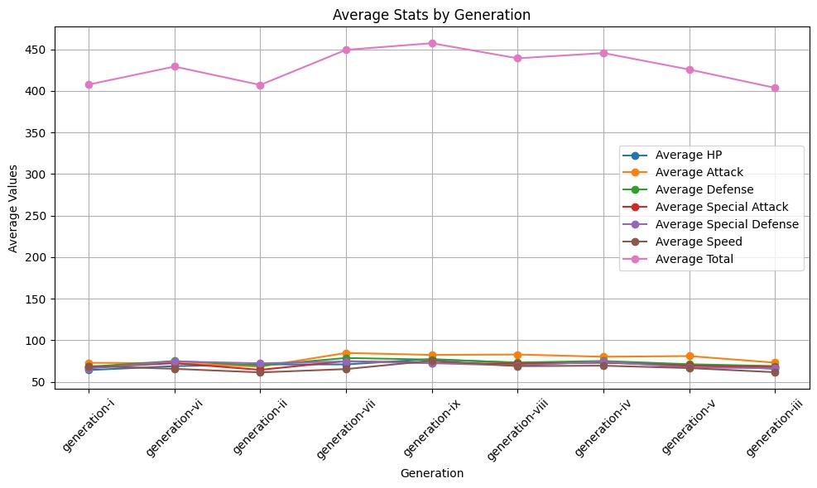
Goal 1: Statistical Analysis of Base Stats Graph

Slide 20
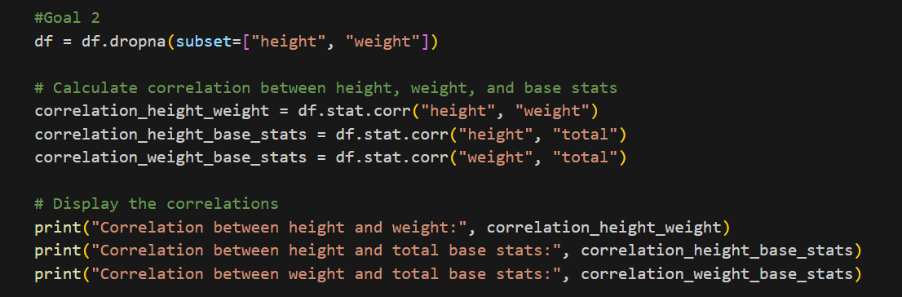
Goal-2: Physical Attributes Exploration
Examining the physical attributes of Pokemon, such as height and weight, to understand the diversity and distribution of sizes among different species, and investigate whether there are any correlations between physical attributes and other characteristics like base stats or evolutionary stage

Slide 21
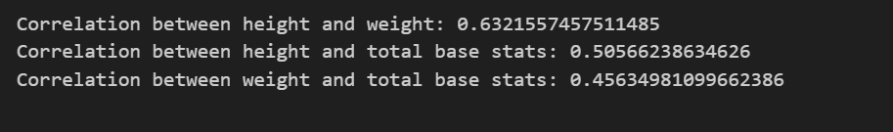
Goal 2- Output:

Slide 22
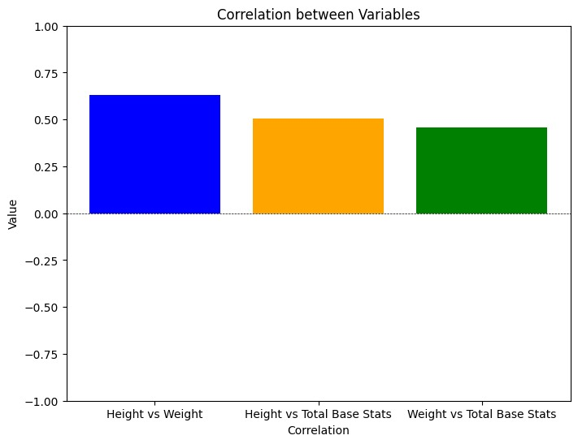
Goal-2: Physical Attributes Exploration Graph

Slide 23
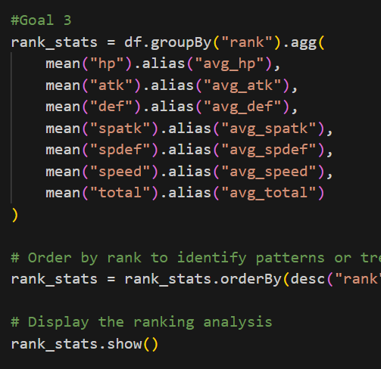
Goal-3: Ranking Analysis
Analyzing Pokemon rankings to understand the factors influencing a Pokemon’s rank, such as its base stats, evolutionary stage, or abilities, and identify any patterns or trends in how Pokemon are ranked across different generations or types.

Slide 24
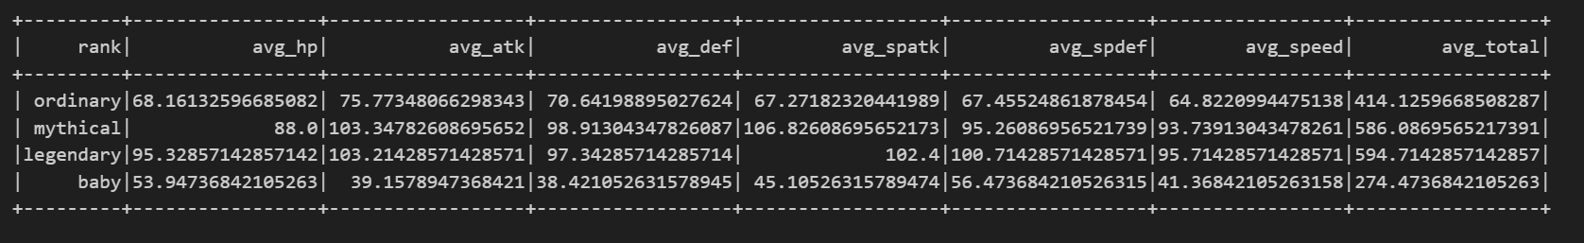
Goal 3- Output:

Slide 25
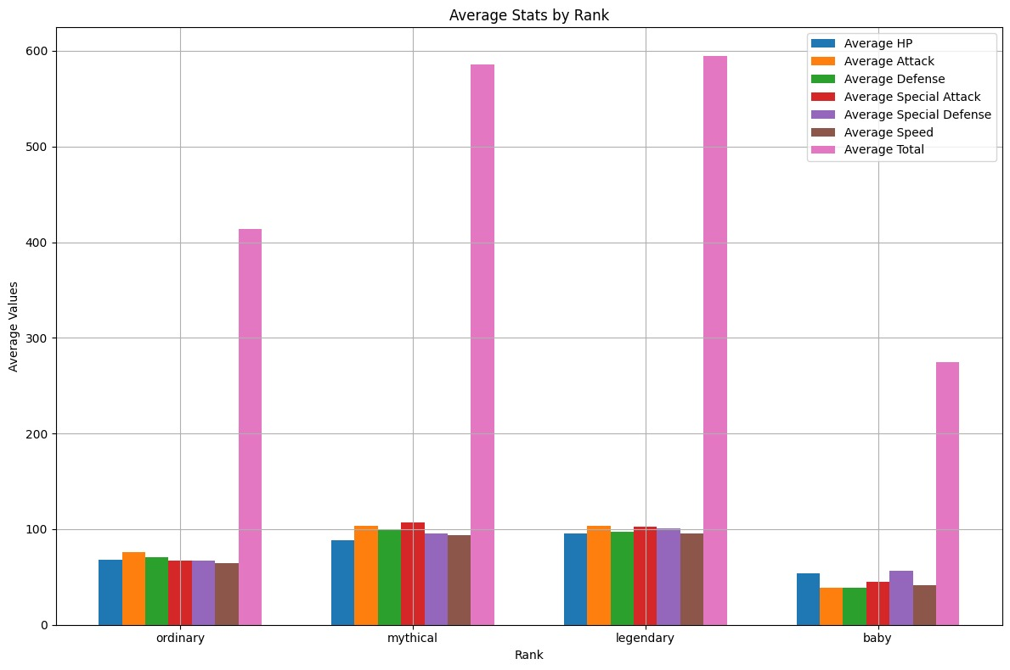
Goal-3: Ranking Analysis Graph

Slide 26
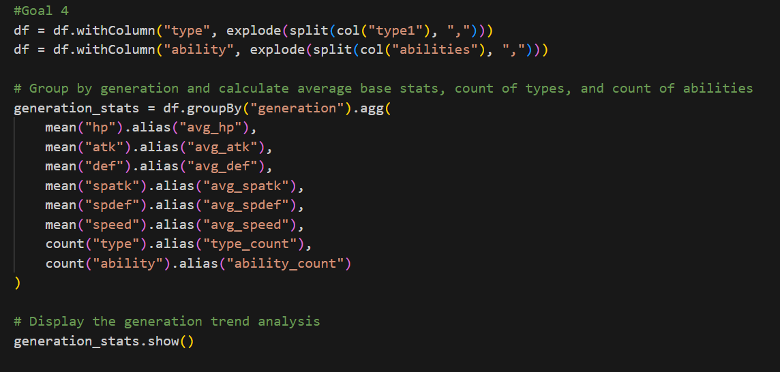
Goal-4: Generation Trend Analysis:
Analyzing trends in Pokemon characteristics (such as base stats, types, and abilities) across different generations to understand how the Pokemon universe has evolved over time and identify any significant changes or developments in gameplay mechanics.

Slide 27
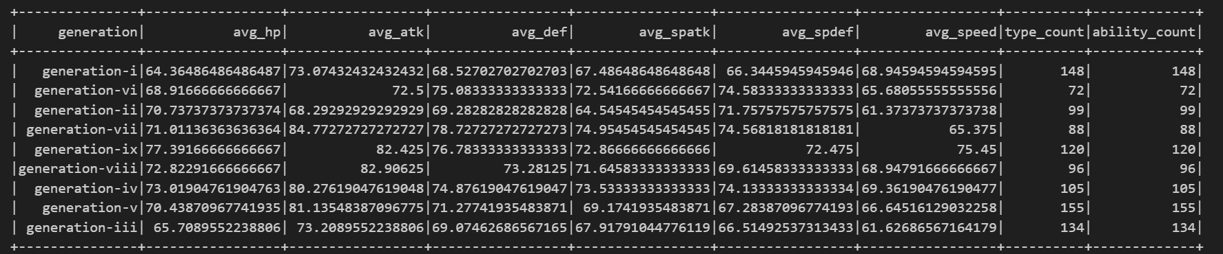
Goal 4- Output:

Slide 28
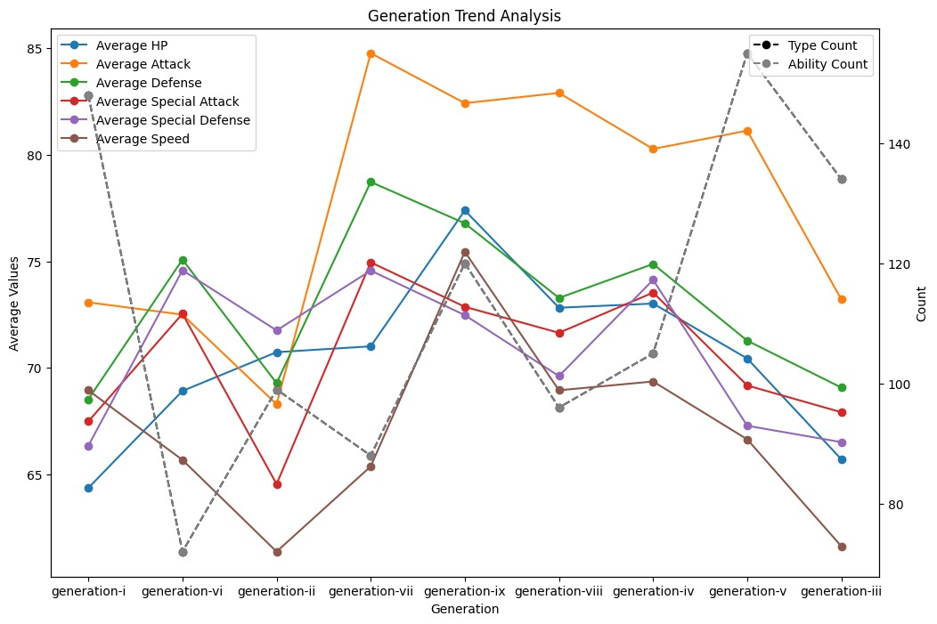
Goal-4: Generation Trend Analysis Graph

Slide 29
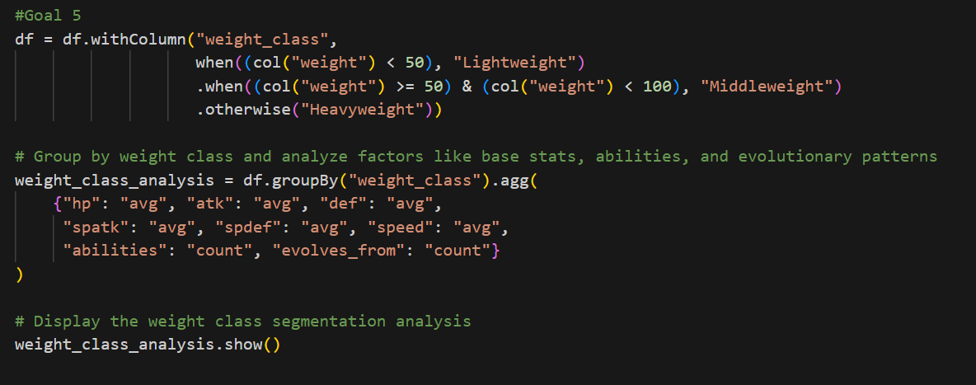
Goal-5: Weight-Class Segmentation
Segmenting Pokemon based on weight classes (e.g., lightweight, middleweight, heavyweight) to analyze how weight influences factors like base stats, abilities, and evolutionary patterns, and identify any correlations between weight class and competitive performance.

Slide 30
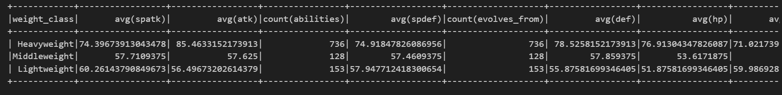
Goal5 -Output:

Slide 31
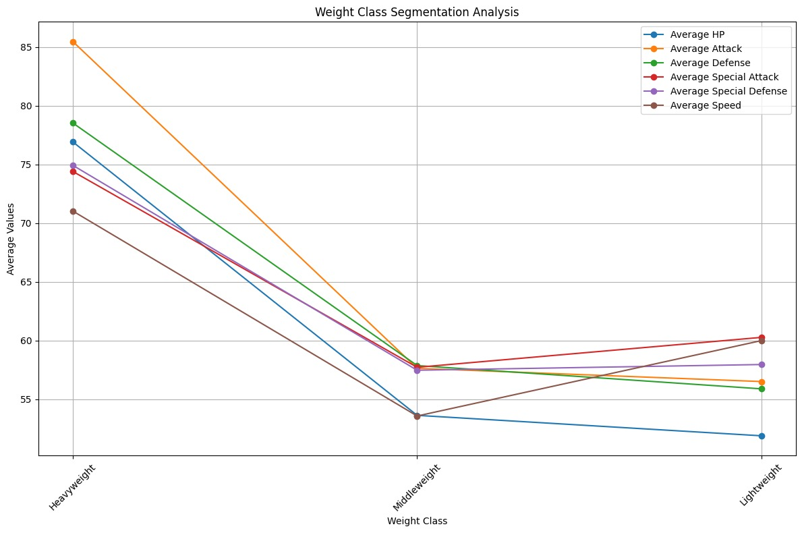
Goal-5: Weight-Class Segmentation Graph

Slide 32
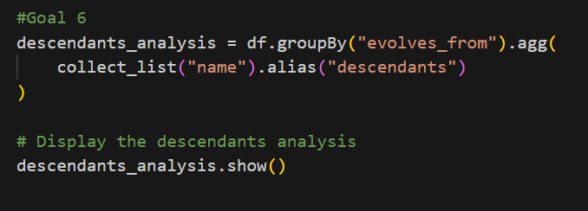
Goal-6: Descendants Analysis
Investigating the descendants of Pokemon species by tracing the evolutionary paths of Pokemon mentioned in the evolves from column, identifying any evolutionary trends or patterns that emerge across generations and types of Pokemon.

Slide 33
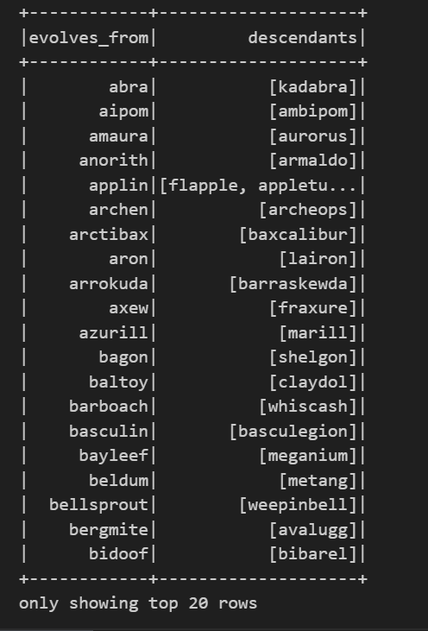
Goal 6-Output:

Slide 34
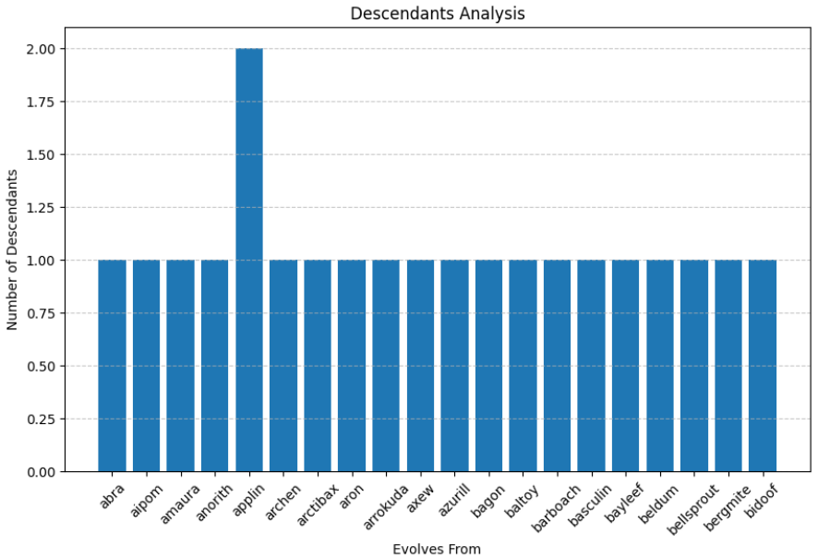
Goal-6: Descendants Analysis Graph

Slide 35
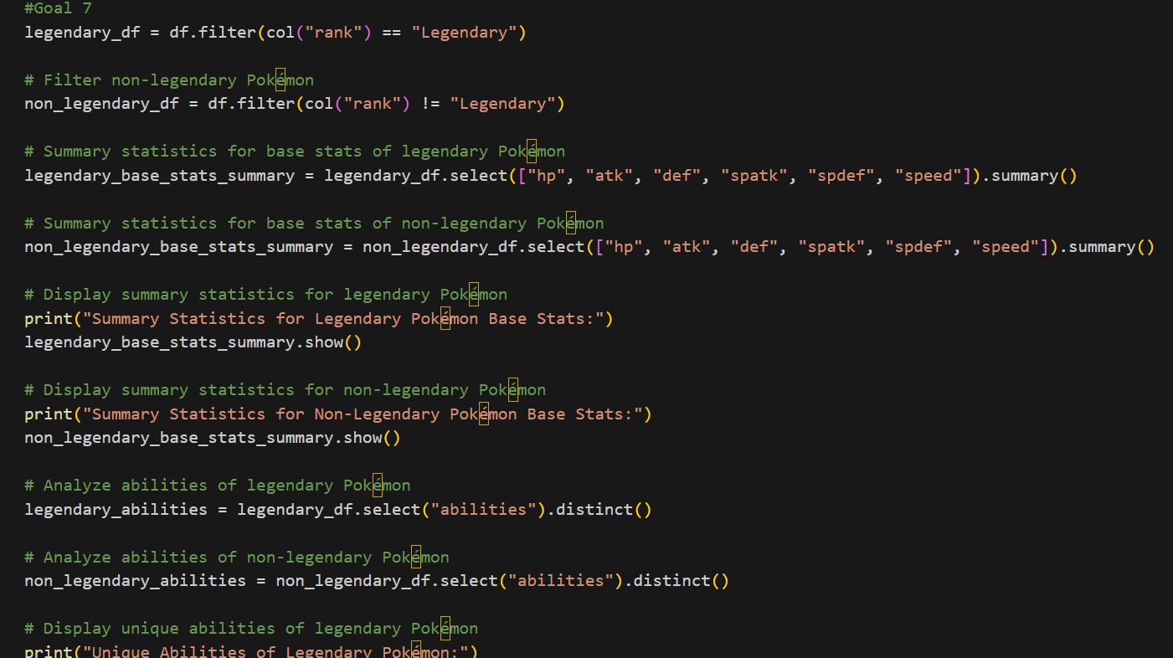
Goal-7: Legendary Pokémon Analysis
Exploring the characteristics and attributes of legendary Pokemon, including their base stats, abilities, and rarity, and analyze how they differ from non-legendary Pokemon in terms of gameplay mechanics and competitive viability.

Slide 36
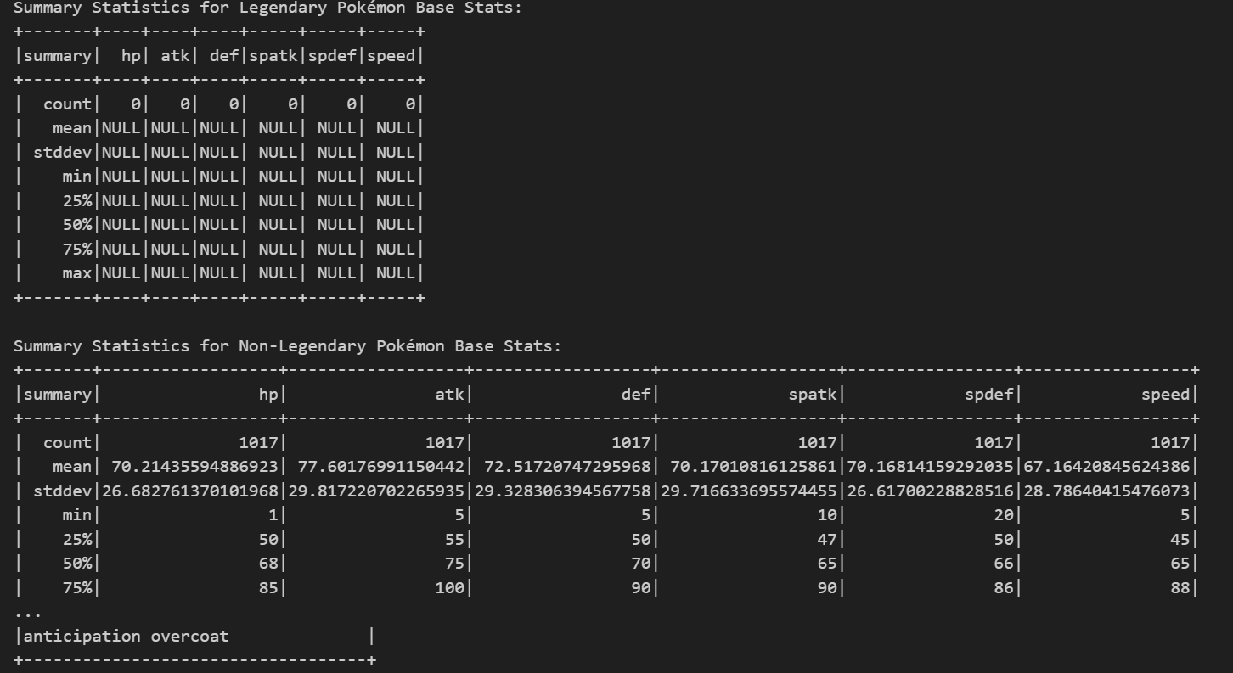
Goal 7- Output:

Slide 37
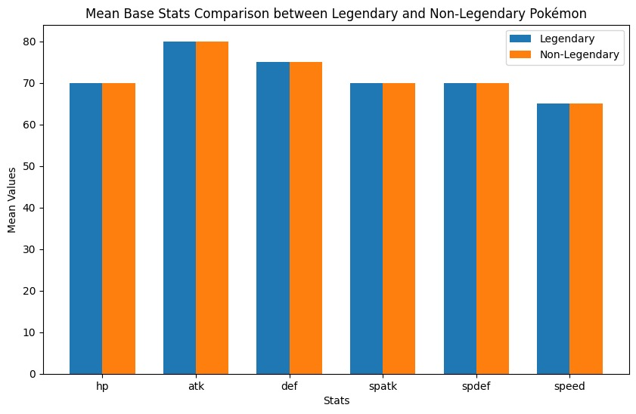
Goal-7: Legendary Pokémon Analysis

Slide 38
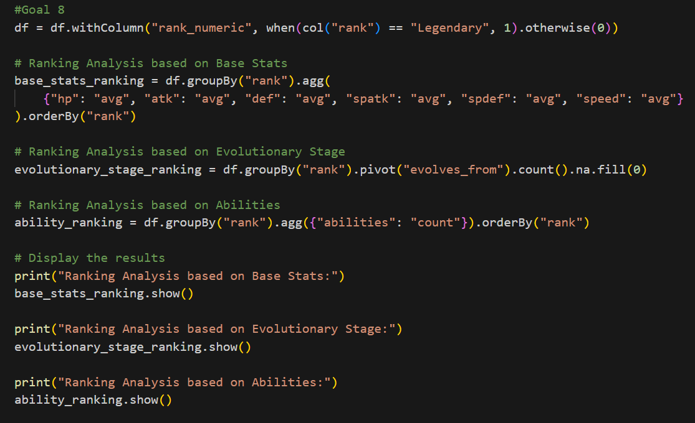
Goal-8: Ranking Analysis
Analyzing Pokemon rankings to understand the factors influencing a Pokemon’s rank, such as its base stats, evolutionary stage, or abilities, and identify any patterns or trends in how Pokemon are ranked across different generations or types.

Slide 39
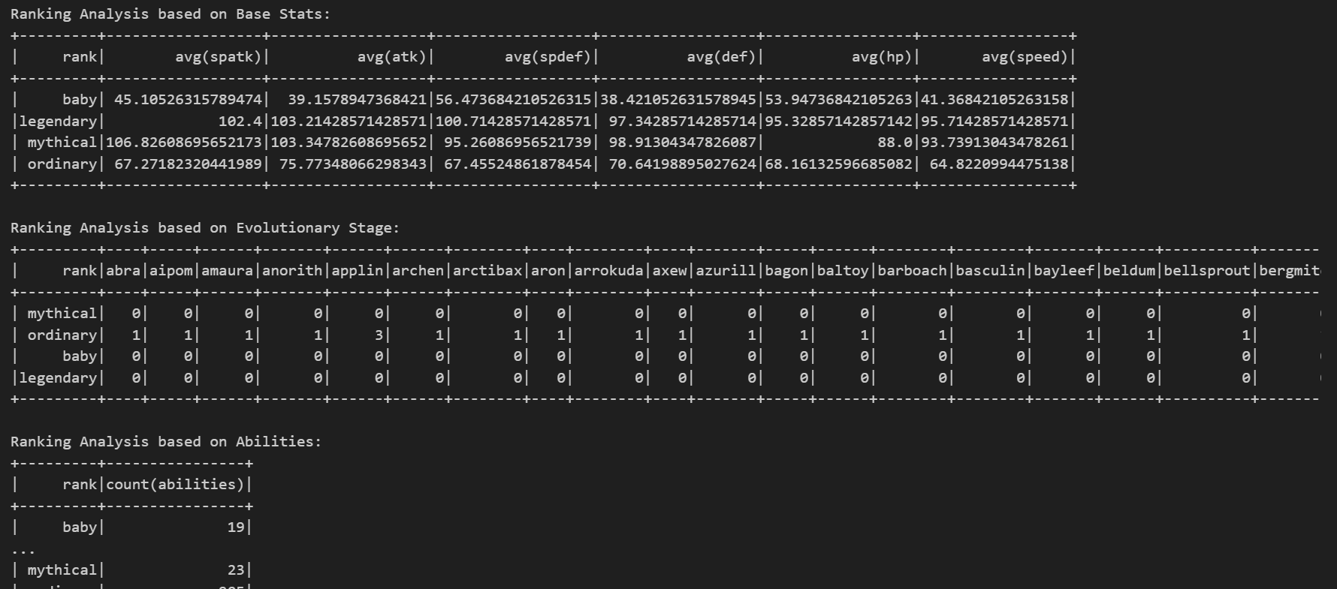
Goal 8-Output:

Slide 40
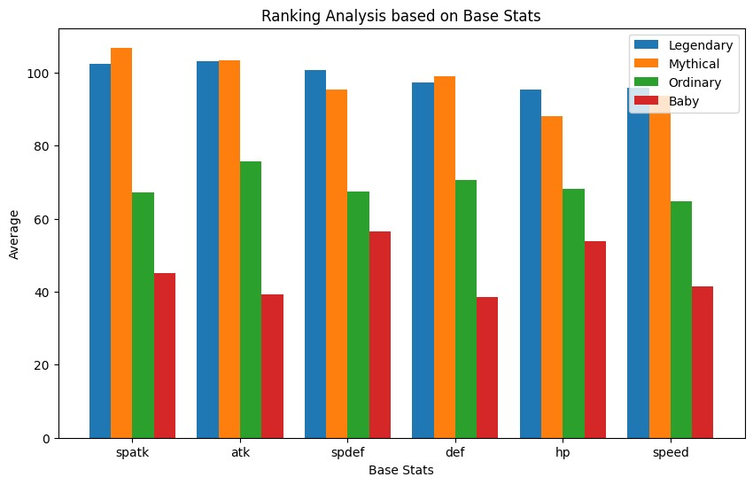
Goal-8: Ranking Analysis

Slide 41
Challenges Faced
The challenges we encountered during project:
Dataset often contain missing or inconsistent data, requiring thorough data cleaning.
Integrating with kafka while producing and consuming the data is challenging.
Generating meaningful visualizations from PySpark DataFrames is challenging.
PySpark execution plans, interpreting error messages became difficult to understand.

Slide 42
Conclusion
We completed a comprehensive study of Pokémon data using PySpark, including evolutionary patterns, fight statistics, ranking analysis, and more.
By exploring different generations, types, abilities, and attributes of Pokémon, we gained insights into how the Pokémon universe has evolved over time and identified trends and patterns that contribute to its rich gameplay experience.
We leveraged matplotlib and other visualization tools to present our findings in an intuitive and visually appealing manner, making it easier to interpret complex data and communicate our analysis effectively.

Slide 43


